Slide 1
Modeling Forest Malaria Using a Time-at-Risk Based Approach
Incorporating Human Movement into the Equation
Alec Georgoff
MMC Meeting, Bangkok, Thailand
November 29, 2018
Notes:
Draw picture of malaria life cycle
More background
Why are we doing this?

Slide 2
Background
What makes forest malaria different?
Risk is spread across different “populations” based on time spent in certain locations
Forest-going population has different risk than those who stay in village
Transmission is occurring away from home
People who travel to the same place form a different population

Slide 3
Contrasting Malaria Models
Ross-Macdonald Model
Entire human population exposed to the same mosquito population
One transmission location
Forest Model
Transmission occurs at home and away from home
Multiple human populations exposed to multiple mosquito populations

Slide 4
Objectives
Show how reproductive rates and time-at-risk can be used together to model malaria prevalence in a forest system
Show why time-at-risk and forest reproductive rates have an impact on elimination in villages

Slide 5
Reproductive Rate

Slide 6
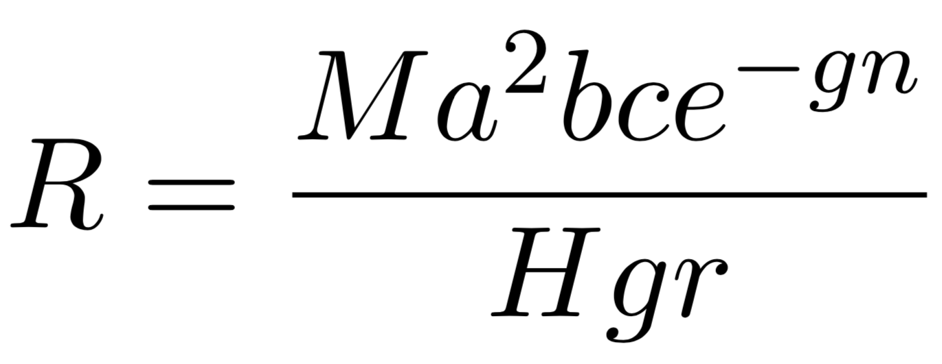
Reproductive Rate
Mosquitoes Per Human
Higher values increase R
Notes:
Combines environmental parameters into one summary parameter
Threshold for elimination
Epi meaning of R
How it’s different in these systems
Local reproductive rate is different between forests and villages

Slide 7
Reproductive Rate
Mosquito Biting Rate
Higher values increase R
Notes:
Combines environmental parameters into one summary parameter
Threshold for elimination
Epi meaning of R
How it’s different in these systems
Local reproductive rate is different between forests and villages

Slide 8
Reproductive Rate
Proportion of Bites That Cause Infection
Higher values increase R
Notes:
Combines environmental parameters into one summary parameter
Threshold for elimination
Epi meaning of R
How it’s different in these systems
Local reproductive rate is different between forests and villages

Slide 9
Reproductive Rate
Time for Sporogonic Cycle
Higher values decrease R
Notes:
Combines environmental parameters into one summary parameter
Threshold for elimination
Epi meaning of R
How it’s different in these systems
Local reproductive rate is different between forests and villages

Slide 10
Reproductive Rate
Mosquito Death Rate
Higher values decrease R
Notes:
Combines environmental parameters into one summary parameter
Threshold for elimination
Epi meaning of R
How it’s different in these systems
Local reproductive rate is different between forests and villages

Slide 11
Reproductive Rate
Human Disease Recovery
Higher values decrease R
Notes:
Combines environmental parameters into one summary parameter
Threshold for elimination
Epi meaning of R
How it’s different in these systems
Local reproductive rate is different between forests and villages

Slide 12
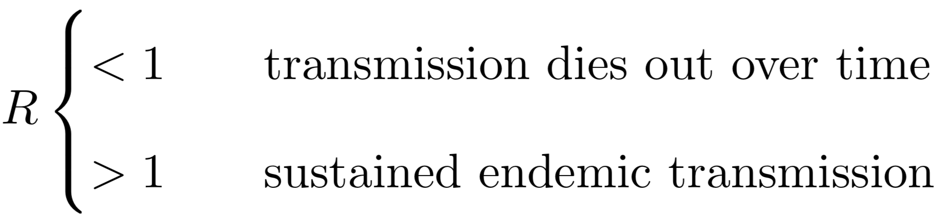

Reproductive Rate
Notes:
Combines environmental parameters into one summary parameter
Threshold for elimination
Epi meaning of R
How it’s different in these systems
Local reproductive rate is different between forests and villages

Slide 13
Time-at-Risk

Slide 14
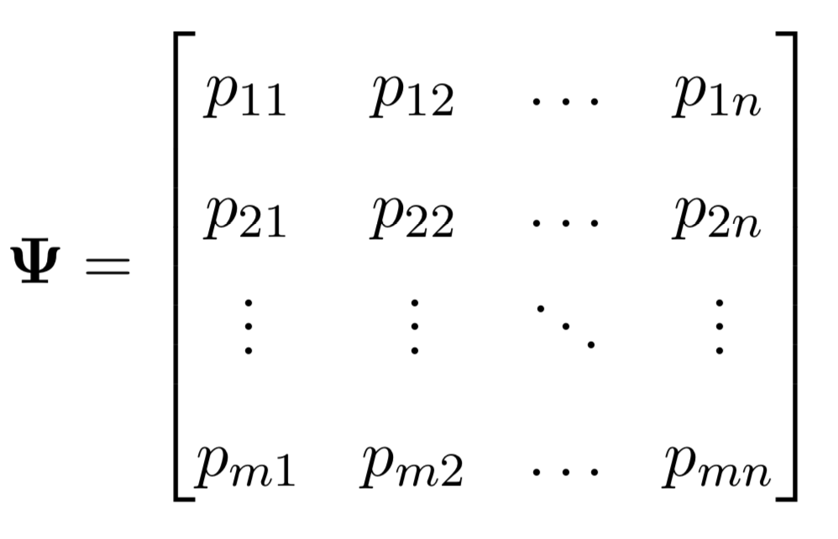
Time-at-Risk (TaR)
Rows Sum to 1
Notes:
Describes how people spend their time
Each row sums to one

Slide 15
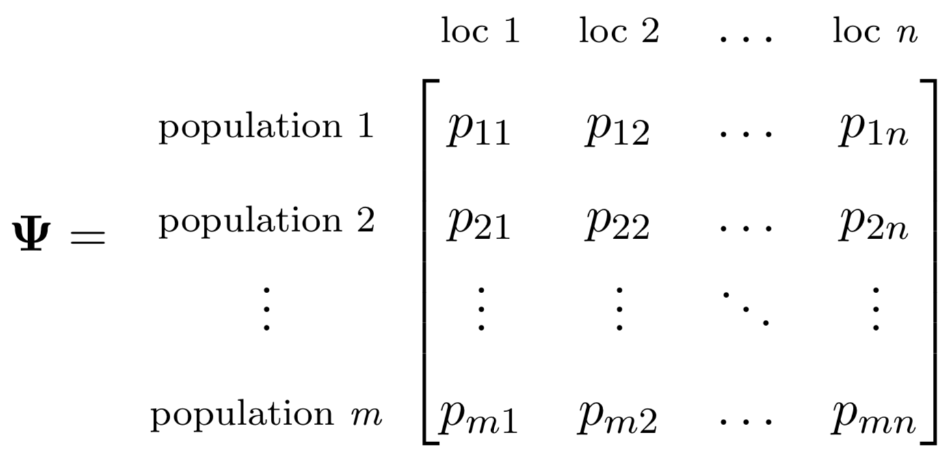
Time-at-Risk (TaR)
Rows Sum to 1
Notes:
Describes how people spend their time
Each row sums to one

Slide 16
Time-at-Risk (TaR)
Proportion of time spent by population 1 in location 2
Rows Sum to 1
Notes:
Describes how people spend their time
Each row sums to one

Slide 17
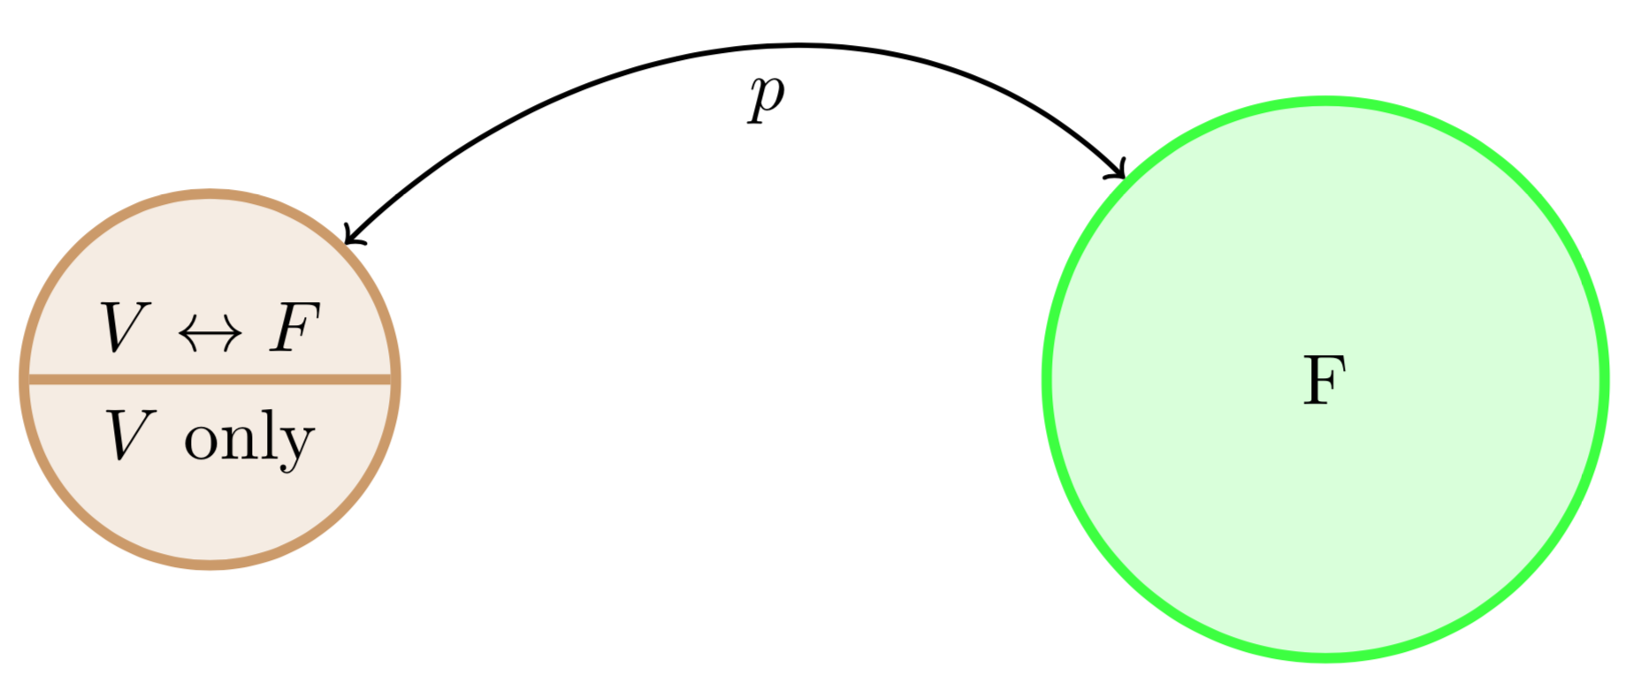
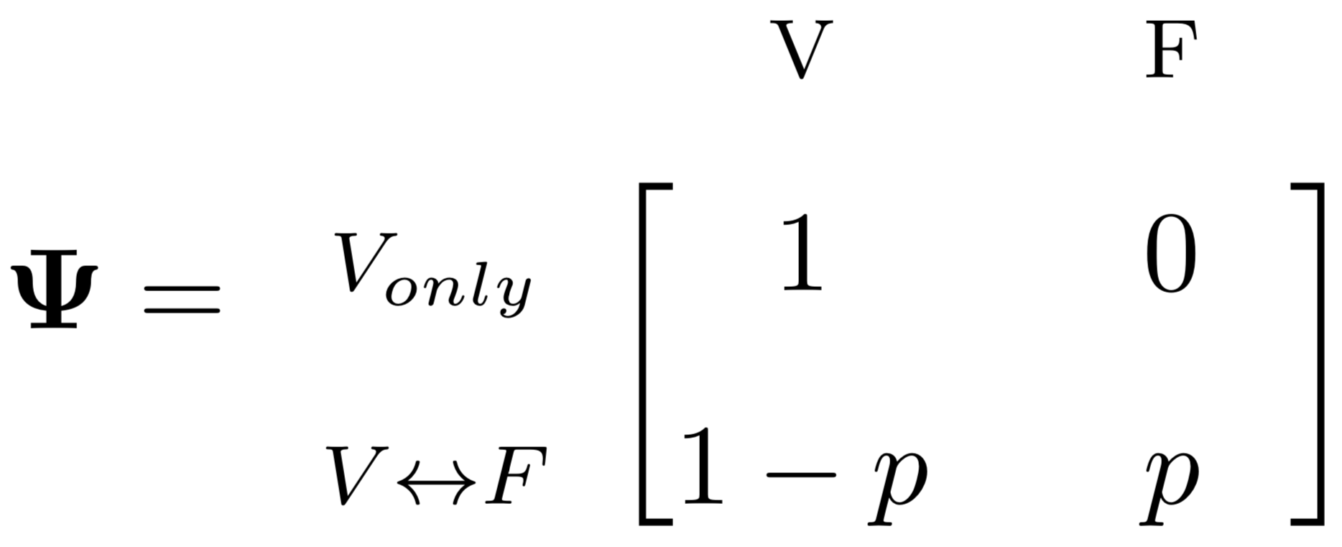
Time-at-Risk (TaR)
Notes:
Simplest possible example
Walk through psi matrix

Slide 18
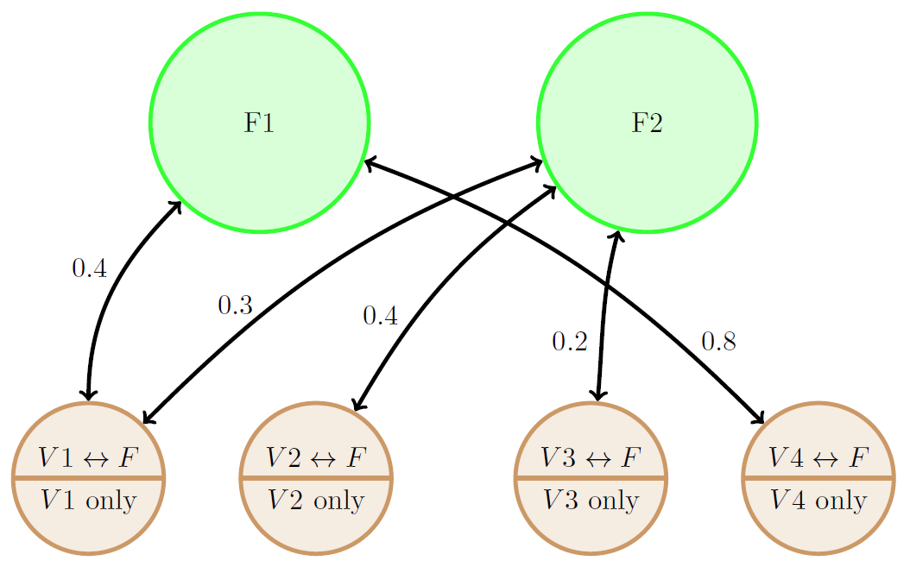
Time-at-Risk (TaR)
Notes:
Populations can travel to multiple forests

Slide 19
Time-at-Risk (TaR)

Slide 20
Time-at-Risk (TaR)

Slide 21
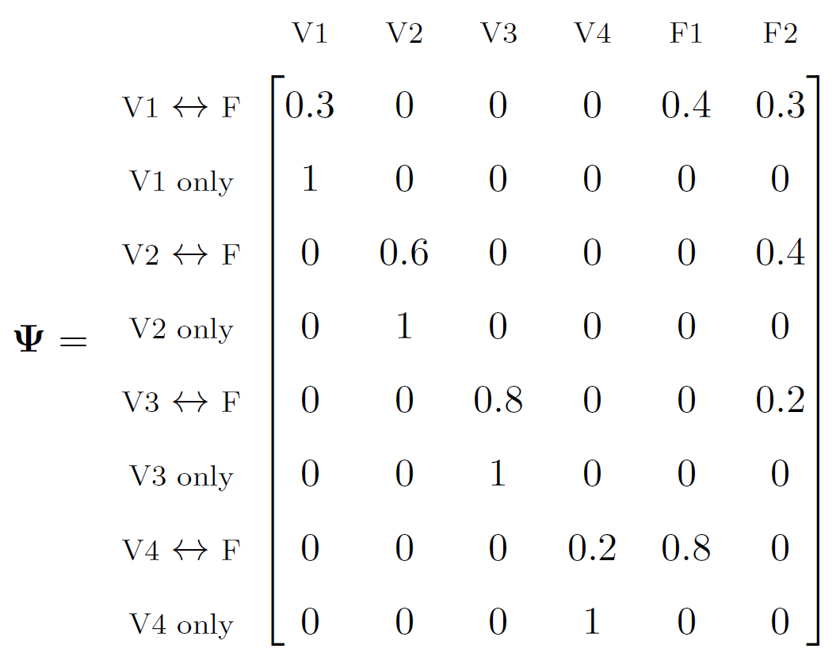
Time-at-Risk (TaR)
Notes:
Rows add up to 1
The p values are what’s really important here
Tie it all to *real* situations

Slide 22
How Forest R and Time-at-Risk Affect Village Transmission

Slide 23
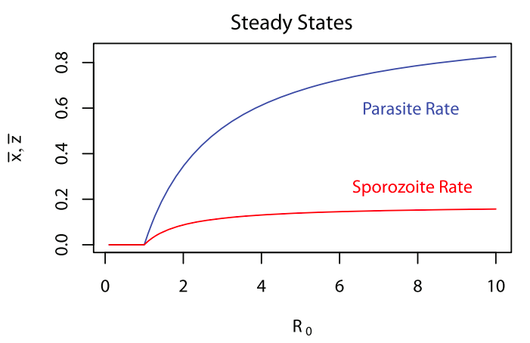
Traditional Model
Every R value has an associated steady state prevalence (derived from parasite rate)
Notes:
Use my model to plot the same thing and show how it’s different (higher R in forest)

Slide 24
Forest Model – Effect of Forest R
Village prevalence at given R value depends on R value in the forest

Slide 25
Forest Model – Effect of Forest R
Village prevalence ranges from 0 to ~0.25 based on forest R value
Village prevalence at given R value depends on R value in the forest

Slide 26
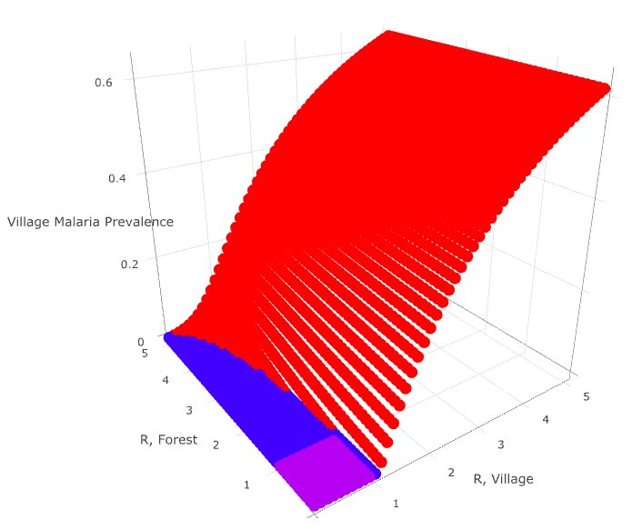
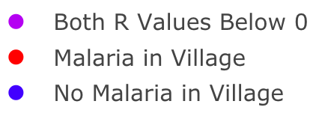
Forest Model – Effect of Time-at-Risk
p = 0.2

Slide 27
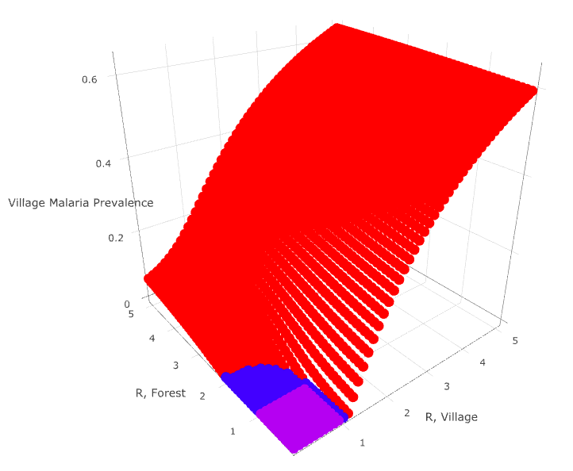
Forest Model – Effect of Time-at-Risk
p = 0.5

Slide 28
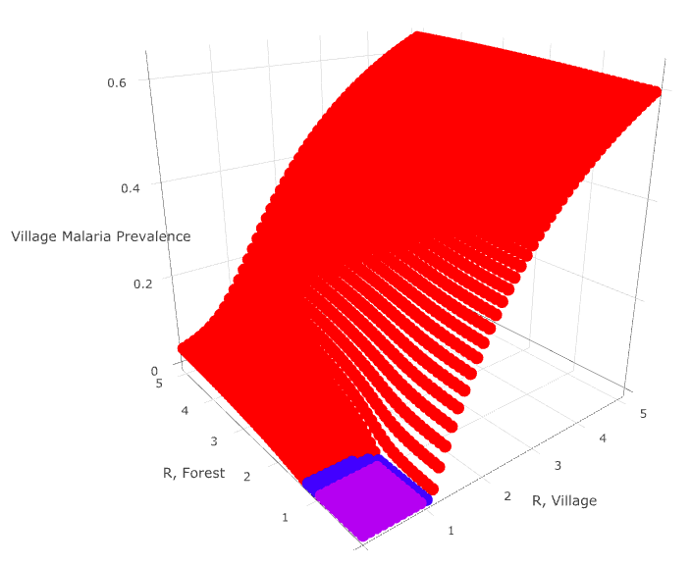
Forest Model – Effect of Time-at-Risk
p = 0.8

Slide 29
Next Steps

Slide 30
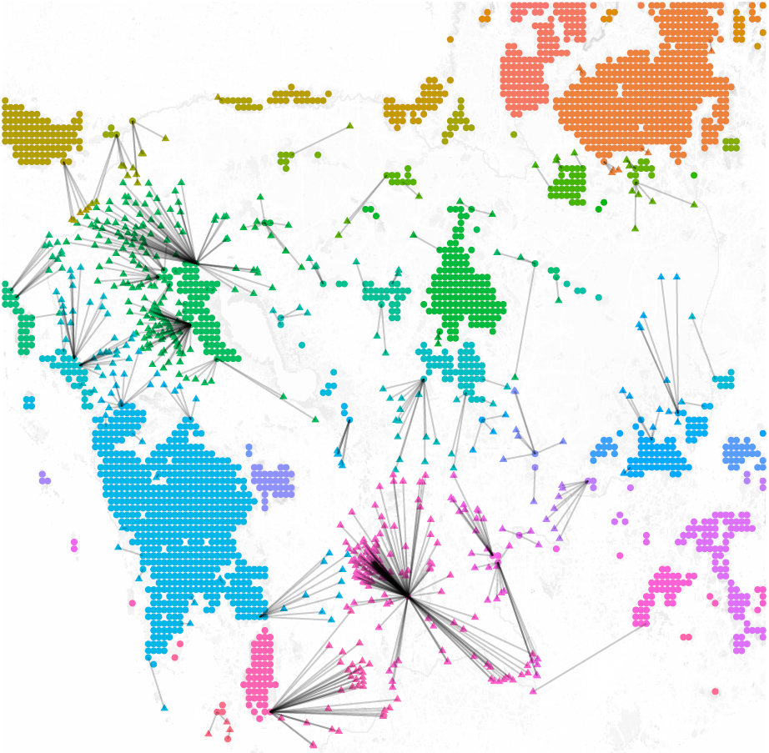
Data, Data, Data
Connecting villages to closest forest by travel time
Sources:
Satellite landcover data,
OSM village locations,
Friction travel surface
Notes:
Attempt to use high level, publicly available data – not super believable
Creating populations of people that are linked by transmission in forests
Understanding these networks will allow us to better tailor interventions
*we can estimate these quantities*
How do we take complicated data on travel and incorporate it into TaR

Slide 31
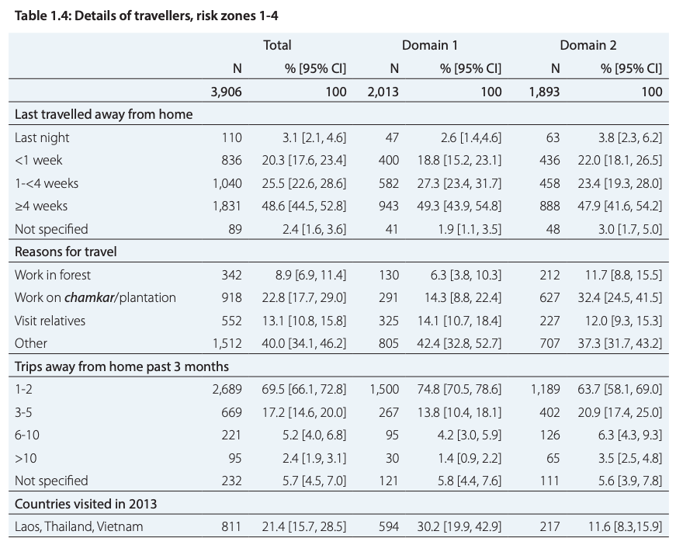
Data, Data, Data
Travel surveys
Source:
Cambodia Malaria Survey 2013
Notes:
Attempt to use high level, publicly available data – not super believable
Creating populations of people that are linked by transmission in forests
Understanding these networks will allow us to better tailor interventions
*we can estimate these quantities*
How do we take complicated data on travel and incorporate it into TaR

Slide 32
Data, Data, Data
Use data to build a realistic TaR matrix
Notes:
Attempt to use high level, publicly available data – not super believable
Creating populations of people that are linked by transmission in forests
Understanding these networks will allow us to better tailor interventions
*we can estimate these quantities*
How do we take complicated data on travel and incorporate it into TaR

Slide 33
Takeaways
Standard Ross-Macdonald models are not sufficient for modeling forest malaria
Time-at-Risk accounts for human travel and its impact on population definitions
Transmission dynamics in the forest can have a large impact on transmission dynamics in the village
Data from high and low level sources are needed to accurately represent the TaR matrix

Slide 34
Questions?

Slide 35
Visualizations
Heatmap
3D Surface
Notes:
Simple example gives us some cool visualizations

Slide 36
Objectives

Slide 37
Objectives
Mathematical
Underpinnings
The basics of mosquito math
Vector-Based
Approach
Multiple locations in one equation
Simple
Example
One village, one forest
Expanded
Example
More villages, more forests!!
R
Implementation
Making computers do the hard math

Slide 38
Objectives
Visualizations
Seeing is believing
Future Directions
Our plans moving forward

Slide 39
Mathematical Underpinnings

Slide 40
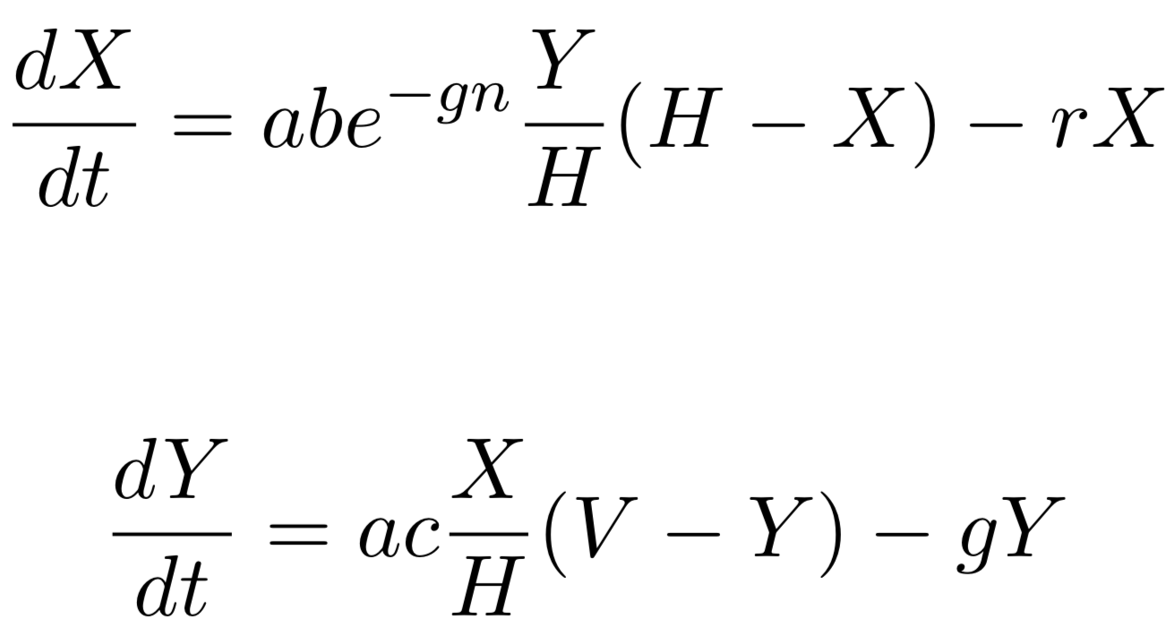
Ross-Macdonald Equations
Infected Humans
Infected Mosquitoes
Notes:
Two equations link together two key parameters (X and Y)
Change V to M
Graphs of RM equations

Slide 41
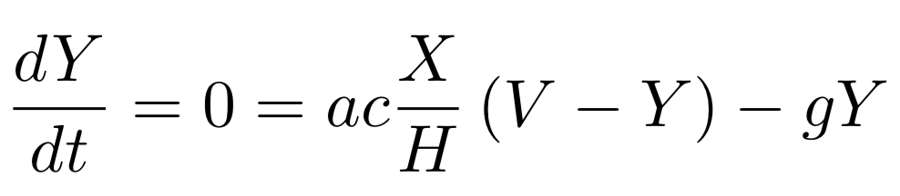
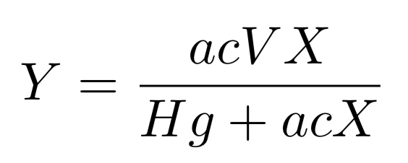
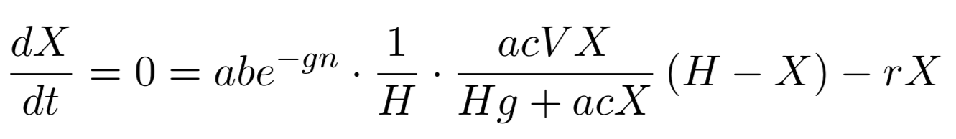
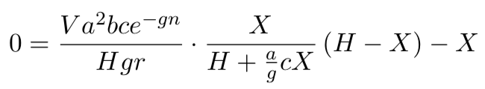
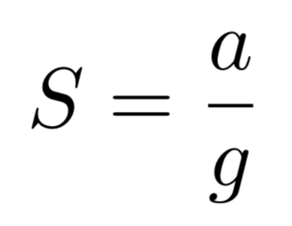
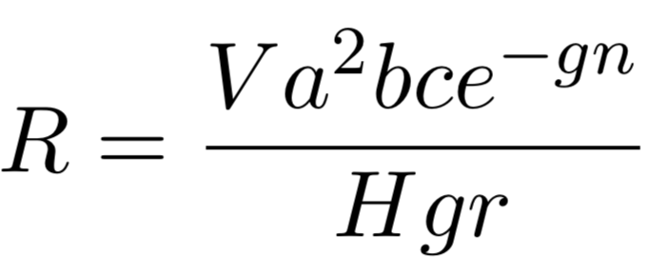
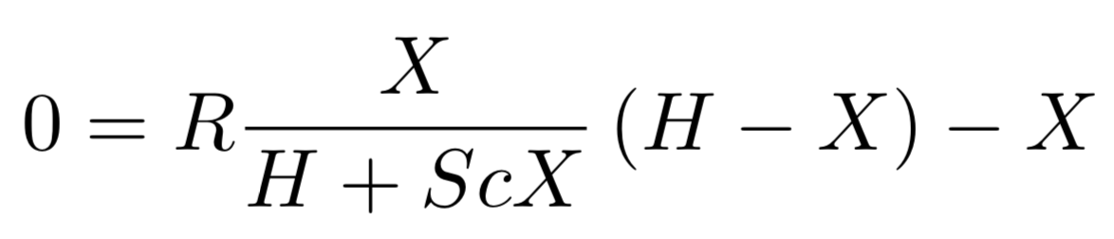
Equilibrium Assumptions
Notes:
Key takeaway: assuming steady state, we can relate X and R in one equation

Slide 42
Equilibrium Assumptions

Slide 43
Equilibrium Assumptions

Slide 44
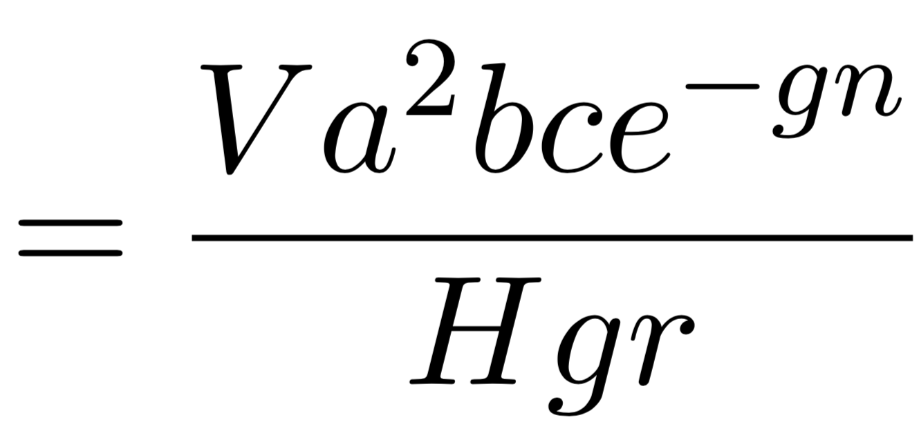
Reproductive Rate
Notes:
Combines environmental parameters into one summary parameter
Threshold for elimination
Epi meaning of R
How it’s different in these systems
Local reproductive rate is different between forests and villages

Slide 45
Multi-Site Approach
Notes:
Use vectors to store values of the same variable in different places
Use “multi patch” or “multi site”

Slide 46
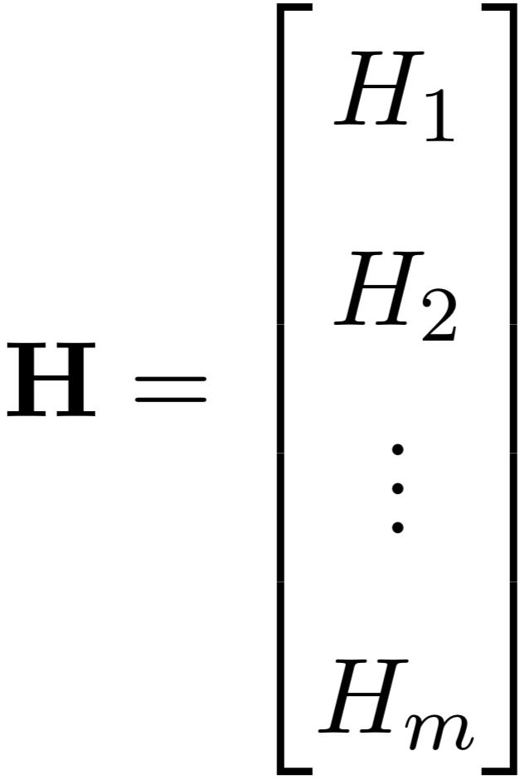
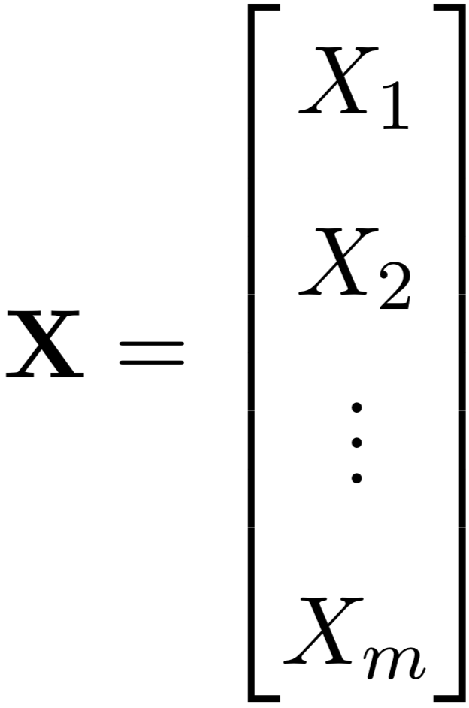
Multi-Site Variables
Notes:
Add picture

Slide 47
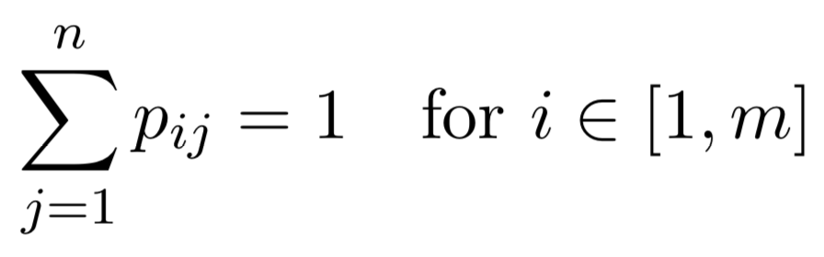
Time-at-Risk (TaR)
Notes:
Describes how people spend their time
Each row sums to one

Slide 48
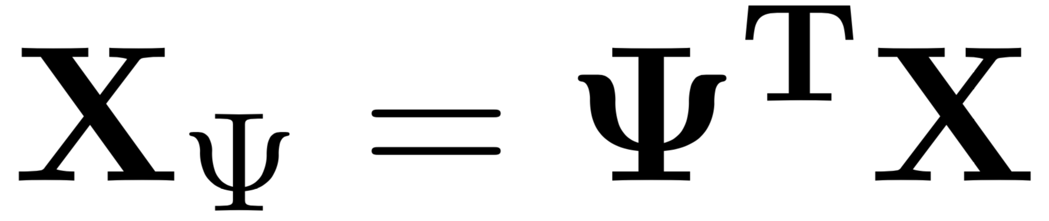
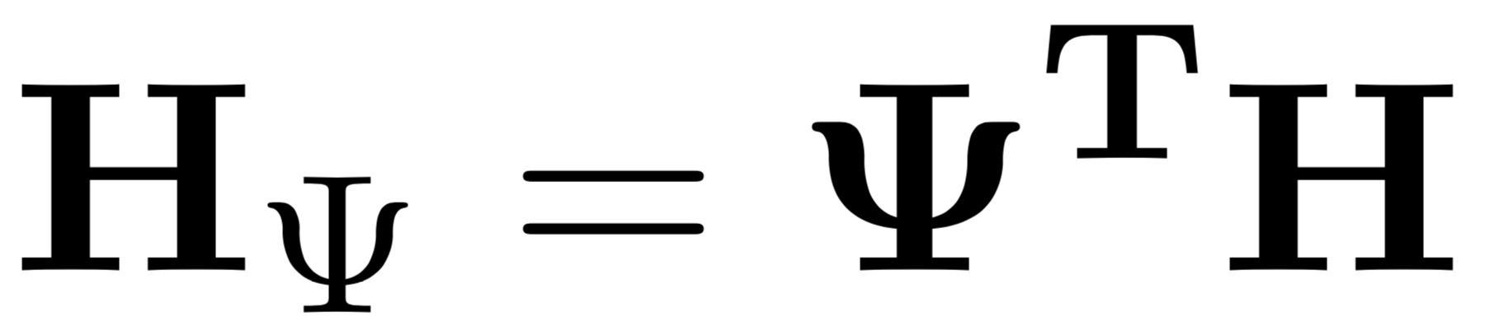
Scaling by Time-at-Risk
Notes:
Can now use psi to scale by time at risk

Slide 49
Ross-Macdonald Equations
Notes:
Back to RM equations from before

Slide 50
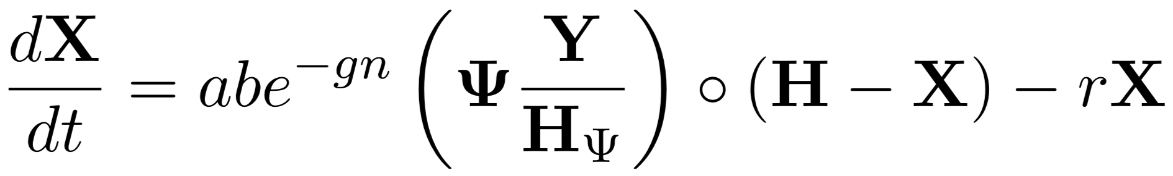
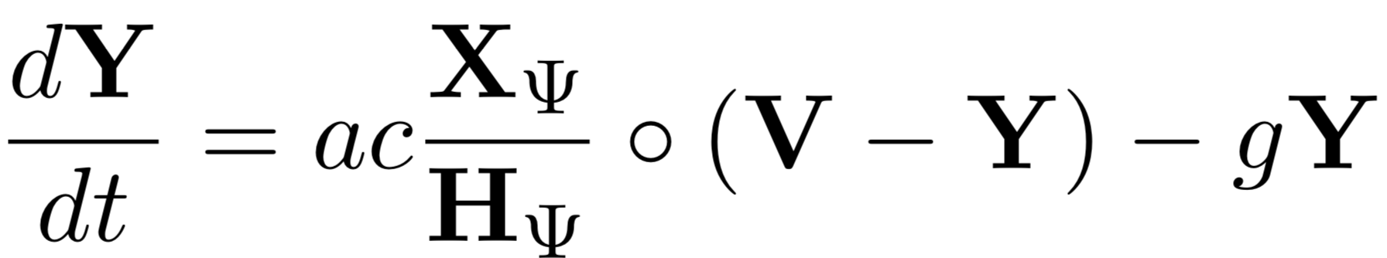
Ross-Macdonald Equations
Notes:
…converted to use vectors and psi matrix

Slide 51
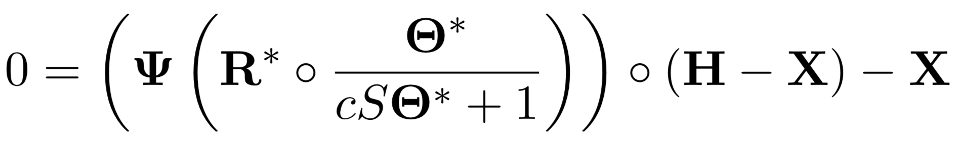
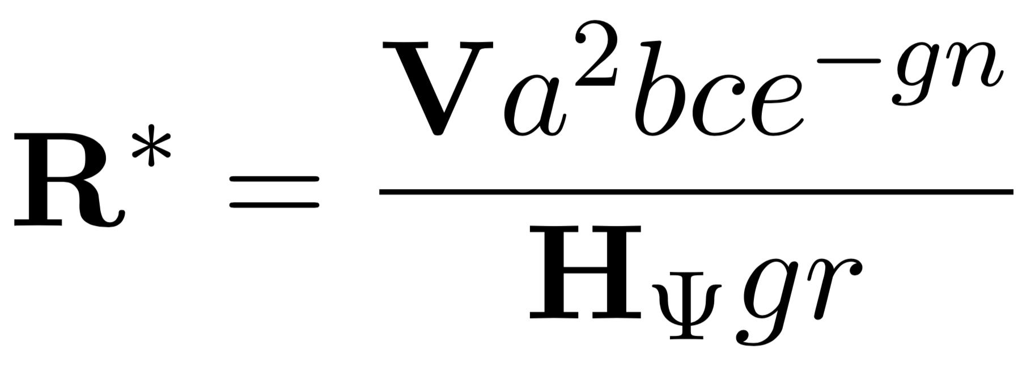
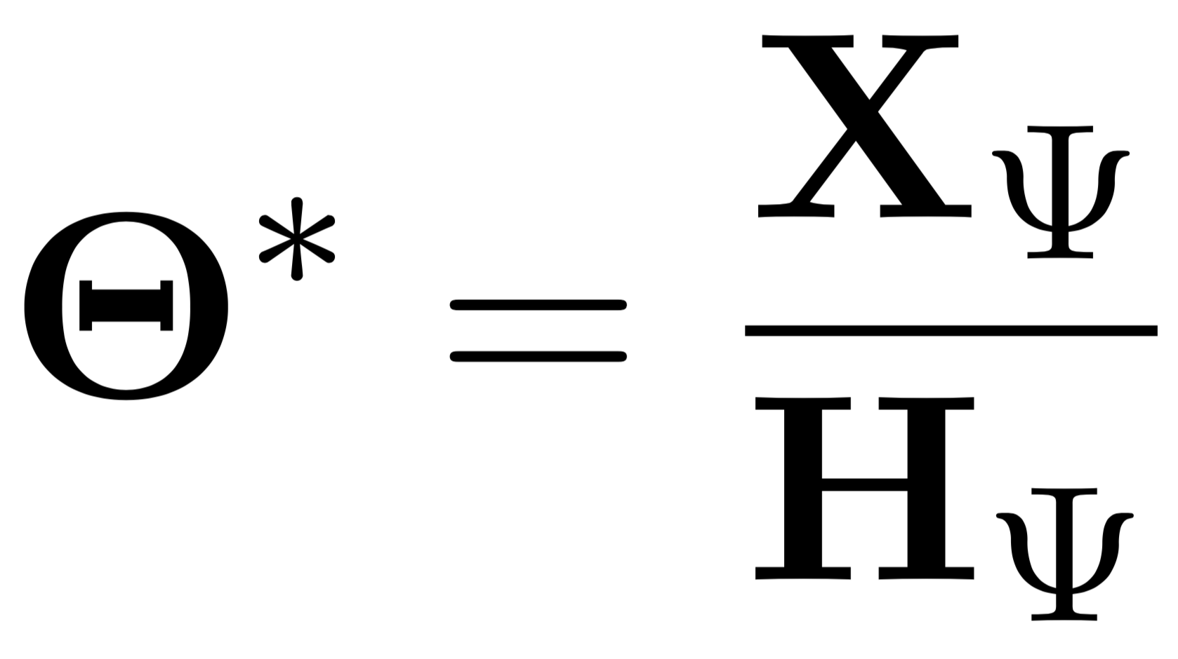
Equilibrium Assumptions
Notes:
Using same steady state assumptions as before, we get equation relating X and R

Slide 52
(Not) Simple Example

Slide 53
Simple Example: One Village, One Forest
Notes:
Simplest possible example
Walk through psi matrix

Slide 54
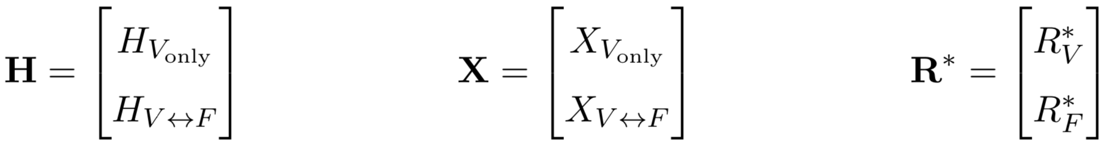
Simple Example: One Village, One Forest

Slide 55
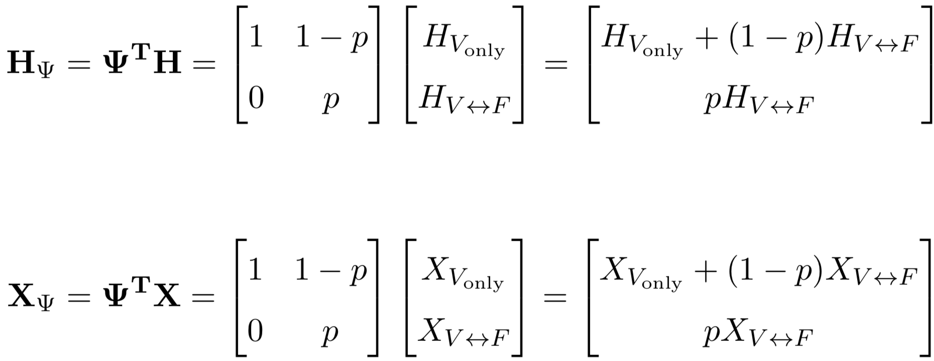
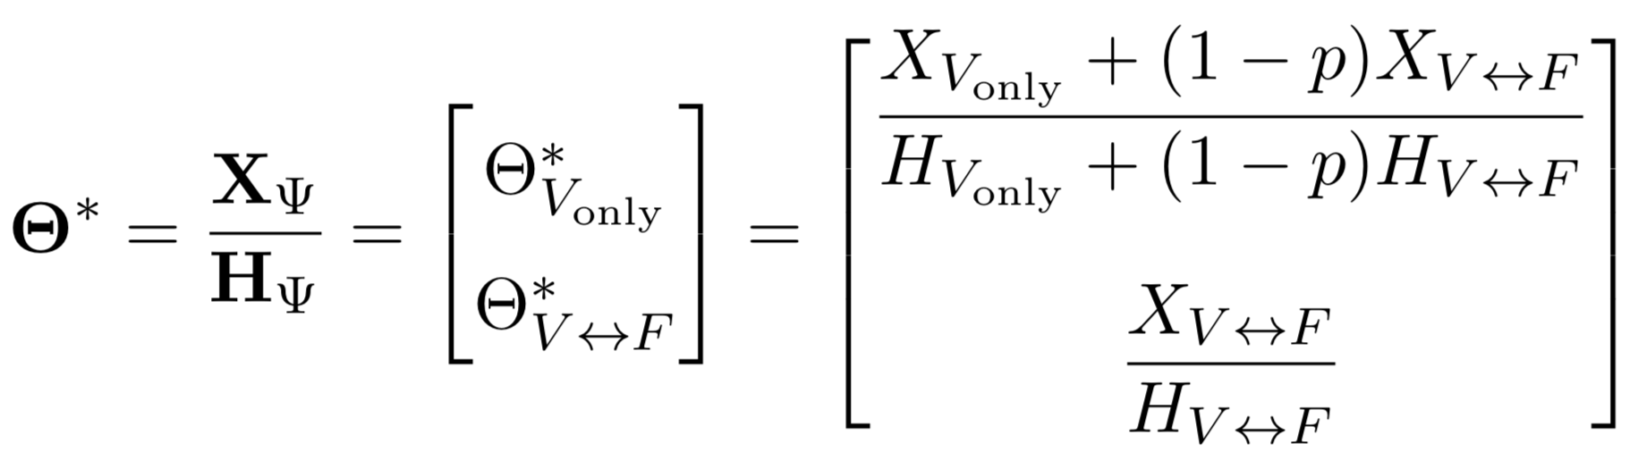
Simple Example: One Village, One Forest
Notes:
Show how populations are scaled

Slide 56
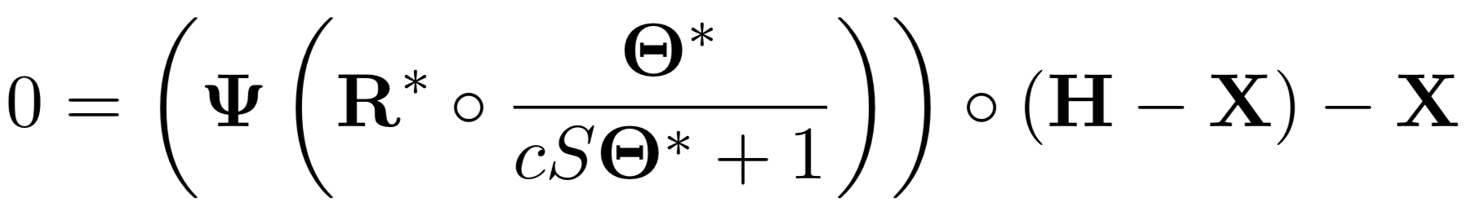
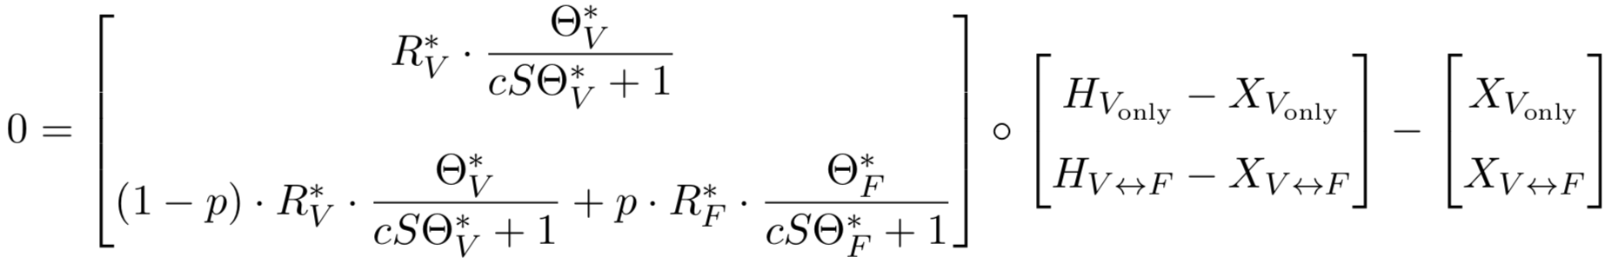
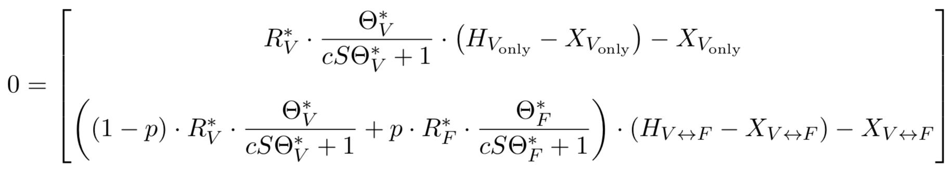
Simple Example: One Village, One Forest
Notes:
Once again relating R and X

Slide 57
Expanded Example

Slide 58
Expand to More Villages and Forests
Notes:
Populations can travel to multiple forests

Slide 59
Expand to More Villages and Forests

Slide 60
Expand to More Villages and Forests

Slide 61
Expand to More Villages and Forests
Notes:
Rows add up to 1
The p values are what’s really important here
Tie it all to *real* situations

Slide 62
Implementation In R

Slide 63
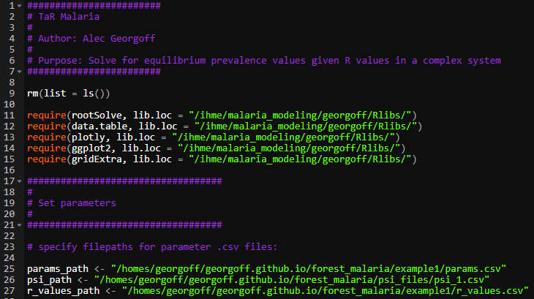
R Code

Slide 64
R Code
Notes:
Parameters are stored in CSVs

Slide 65
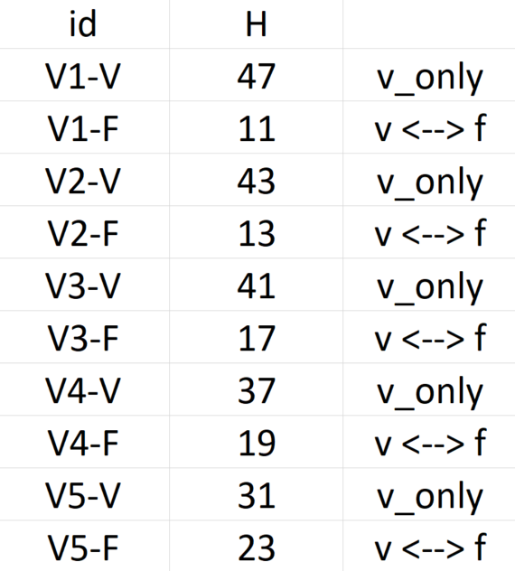
R Code – Parameters
Notes:
UNIQUE human populations

Slide 66
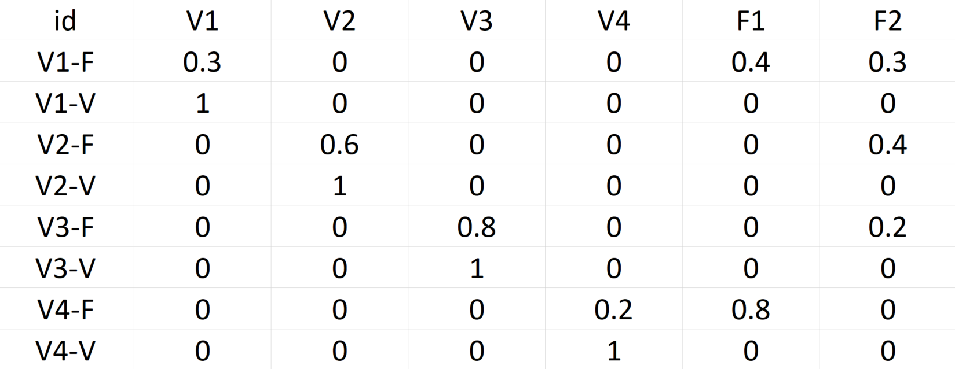
R Code – TaR Matrix
Notes:
TaR matrix

Slide 67
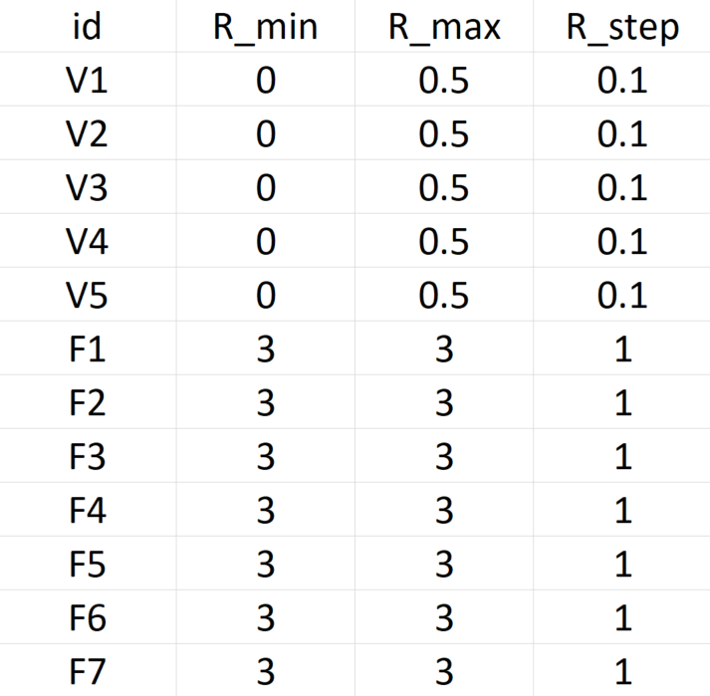
R Code – R Values
Notes:
Explain R ranges and permutations

Slide 68
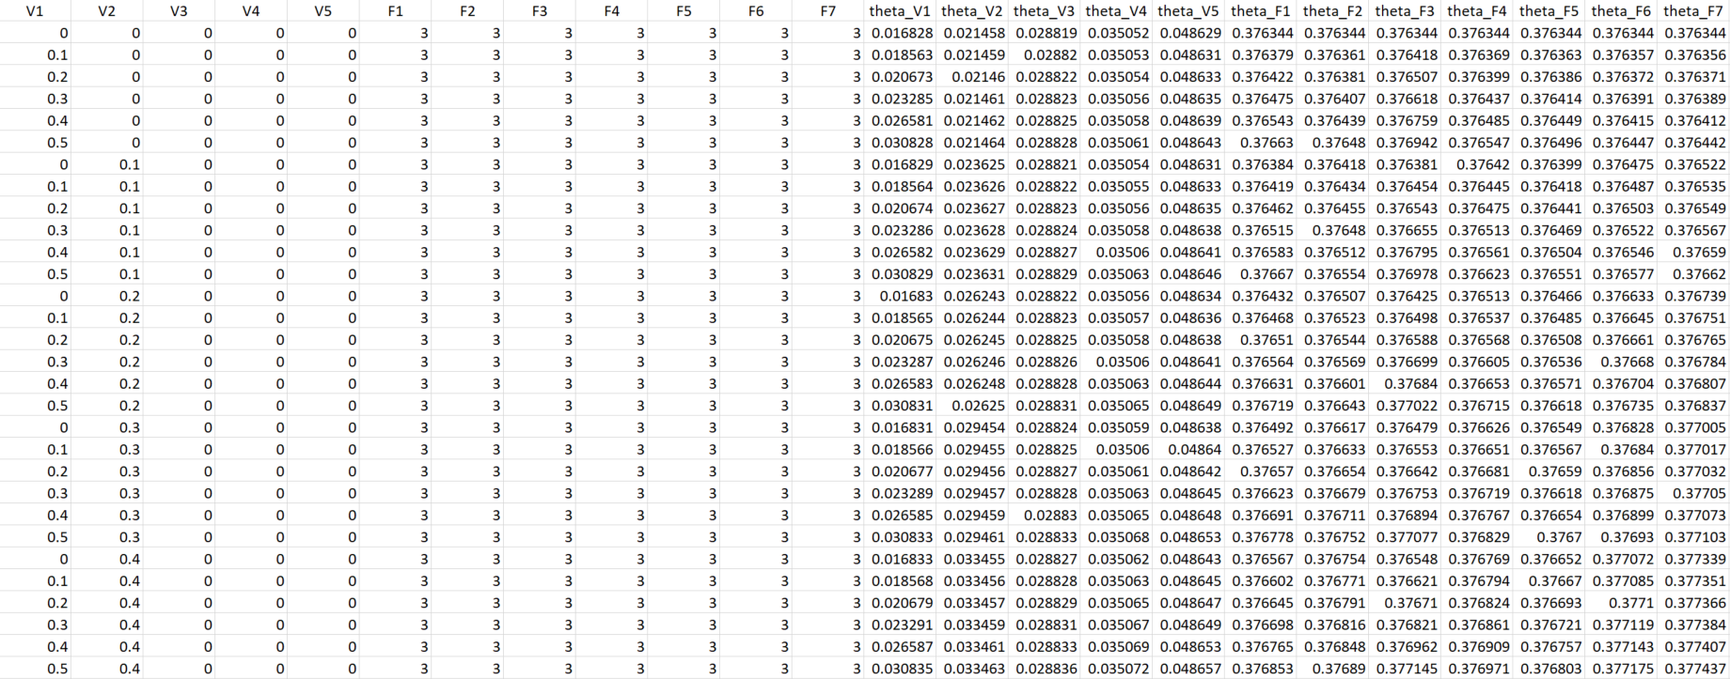
R Code – Results
7776 Rows

Slide 69
Visualizations

Slide 70
Visualizations
Heatmap
3D Surface
Notes:
Simple example gives us some cool visualizations

Slide 71
Visualizations
3 plots of surfaces and heatmaps at different R values

Slide 72
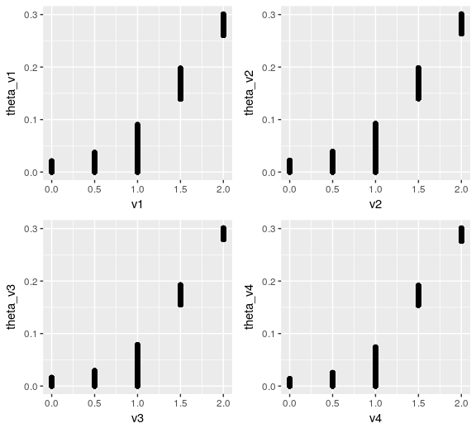
Visualizations
Notes:
Need to do more work on visualizing in higher dimensions

Slide 73
Future Directions

Slide 74
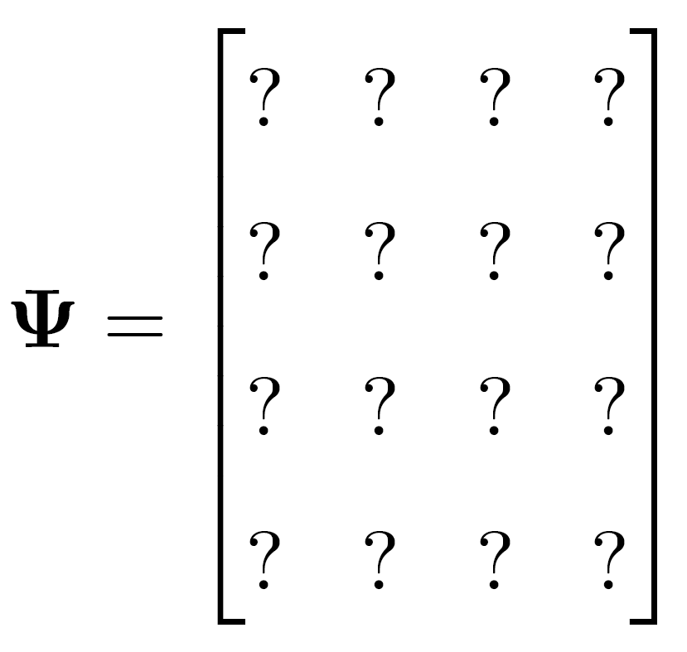
Data, Data, Data
Notes:
TaR matrix is key missing piece
Tie new sources of data to this

Slide 75
Data, Data, Data
Notes:
Attempt to use high level, publicly available data – not super believable
Creating populations of people that are linked by transmission in forests
Understanding these networks will allow us to better tailor interventions
*we can estimate these quantities*
How do we take complicated data on travel and incorporate it into TaR

Slide 76

Model Interface
Notes:
Shiny interface

Slide 77

Questions?

Slide 78
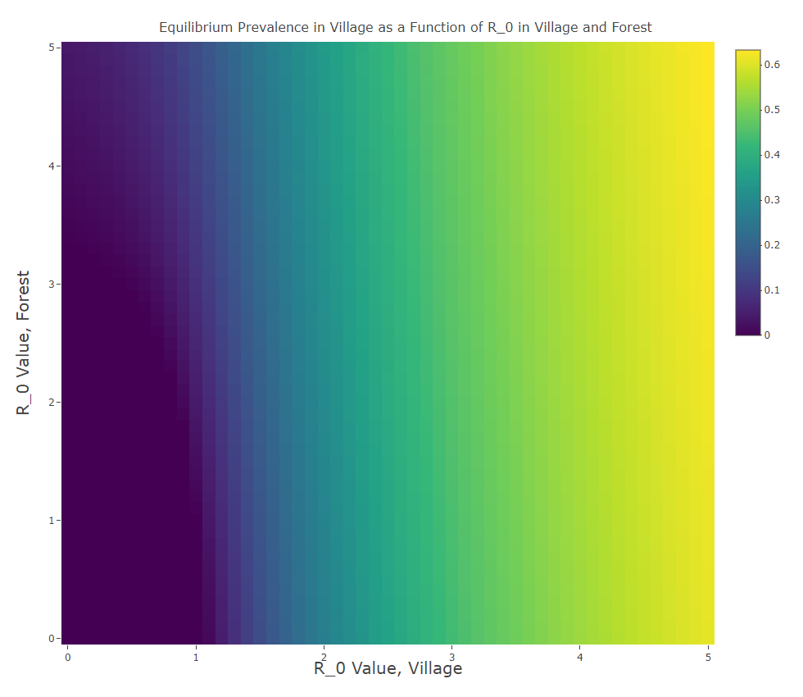

Slide 79
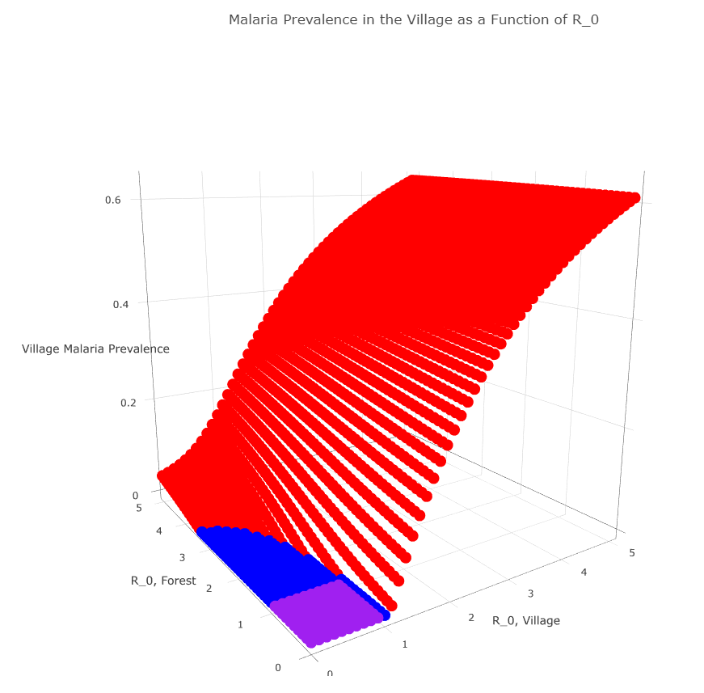

Slide 80

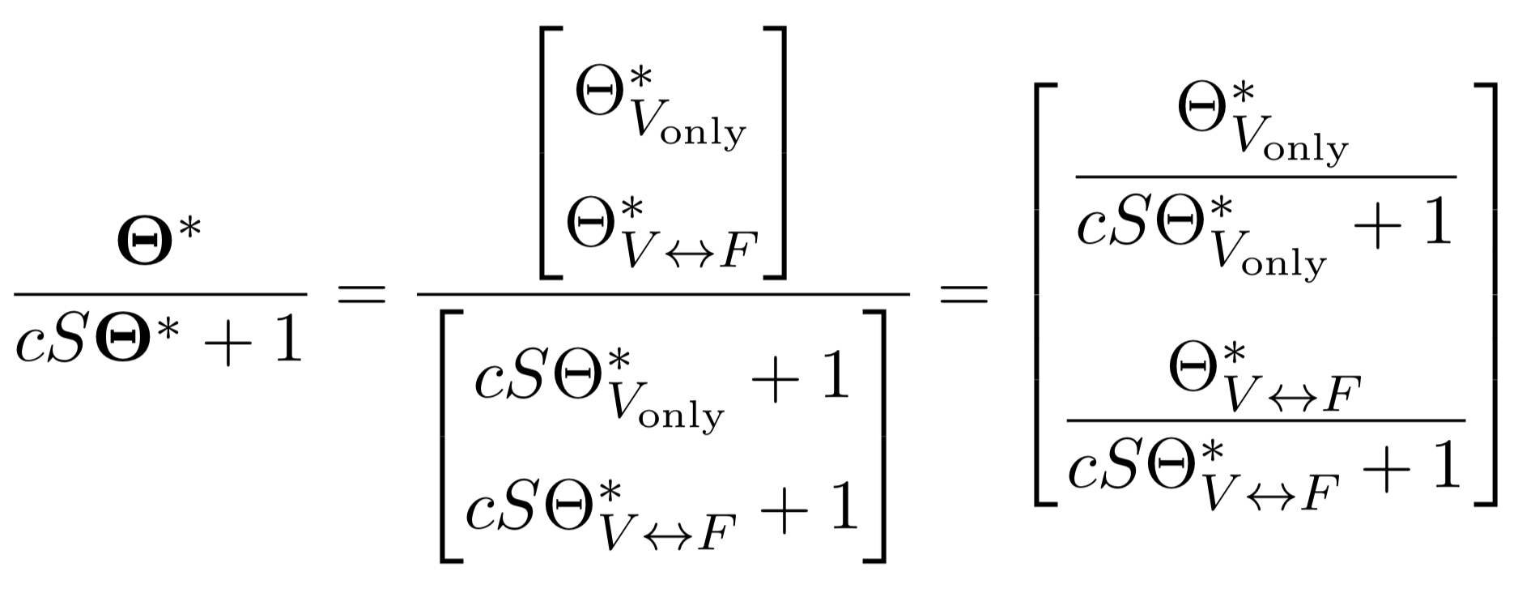
Simple Example: One Village, One Forest
Notes:
delete

Slide 81




Simple Example: One Village, One Forest
Notes:
delete

Slide 82



Vectors of Variables

